Slide 1
We can make a difference
We are more than kids

Slide 2
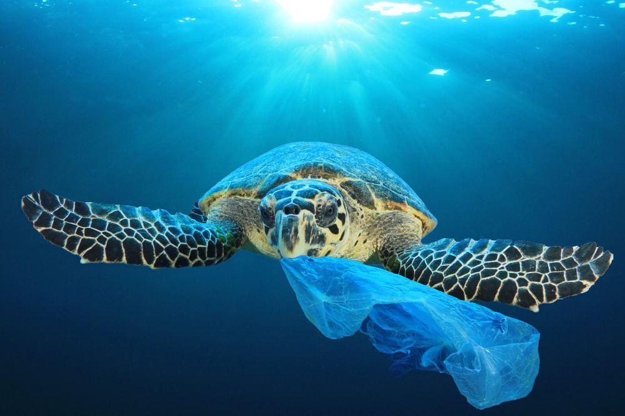
This poor turtle is eating a plastic netting and soon it will tangle with his stomach and he will die.
Many poor animals get this mixed up with food and sadly die but we can but an end to this. We’re the ones who created this mess so we’re the ones who can end it !!

Slide 3
We are more than we can imagine so we need to take a stand and show the world what we can really do. As a class, we can work together and save the world from pollution. WE ARE MORE THAN STUDENTS. WE ARE MORE THAN KIDS. We are people who make a difference. We are people who care about the world. We are people who, Never Give Up.
You, yes you, have given us a chance to explore, be free, and let no one tell us we can’t do what we love most, to save our home.

Slide 4
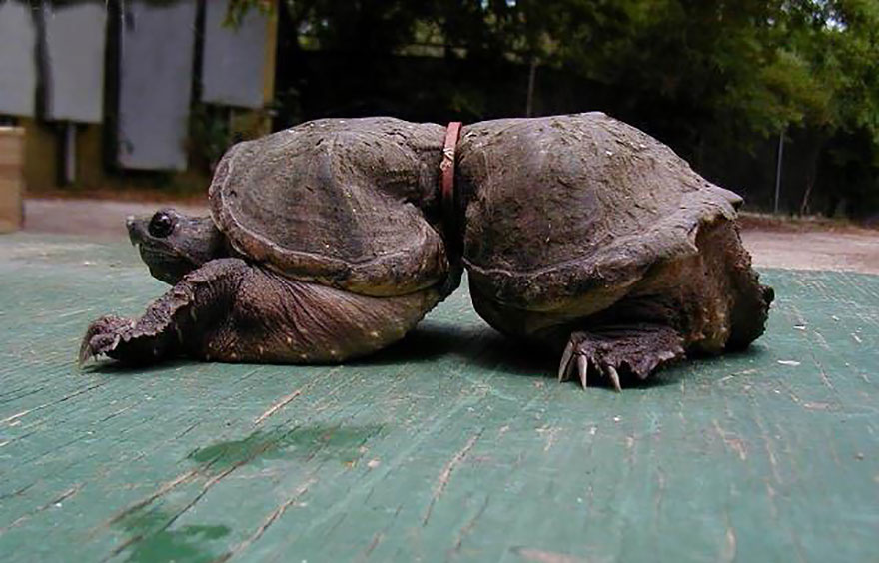
Notes:
Poor turtle

